Slide 1
Amazing Music
A Music Editing and Sharing Desktop App
July 25th, 2018
Team Members:
Chongwei Zhao (Product Owner), In Young Cho,
Dong Yeun Lee, Bali Southam, William Whelan
Sponsor: Yibo Guo

Slide 2
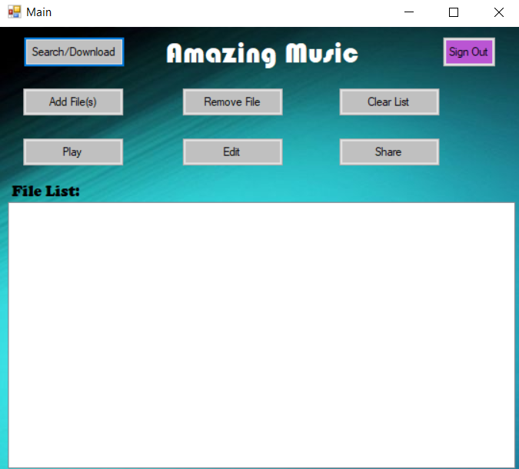
Problem/Motivation
Many apps exist to edit or play or share music
Apps typically accomplish only one or two of the above features
Amazing Music seeks to create a platform to accomplish all three within a single application

Slide 3
Goals
Create an attractive, user friendly Windows Desktop application
Let users play an audio track within the application
Allow reliable pitch, tempo, and file cutting editing of audio tracks
Create a platform allowing users to upload their edited audio files
Allow users to access and download others’ uploaded audio tracks

Slide 4
Challenges
All of us were dealing with unfamiliar technologies
Struggles completing tasks by initial expected deadline- many tasks pushed to following sprint
Language/Communication barrier
Difficulties agreeing upon direction of the project/ disputes with sponsor/ disagreements on structure
Difficulties combining separate elements of project (client and server, UI and client/server, etc.)

Slide 5
Accomplishments
Functional, attractive user interface was implemented
Generally, communication between members was positive and constructive
Product meets almost all of our functional requirements
In general, division of work was fair and well established

Slide 6
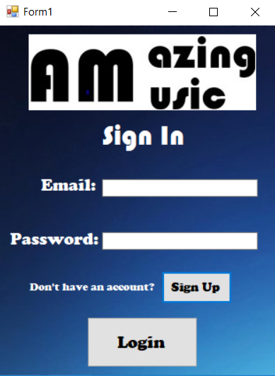
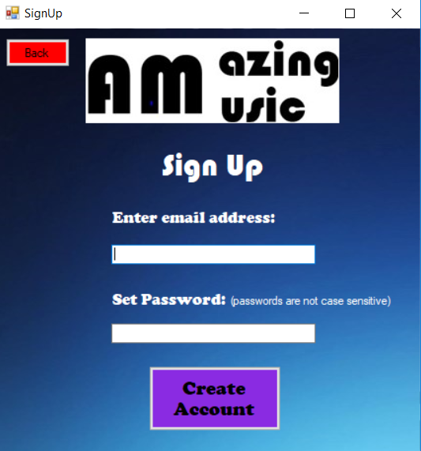
Application Screenshots

Slide 7
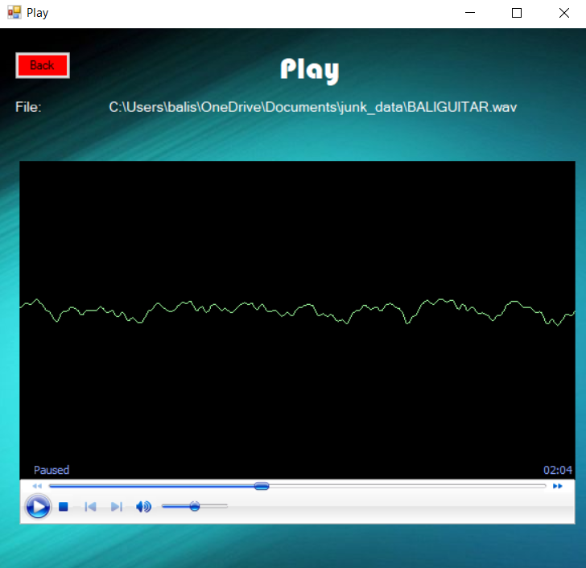
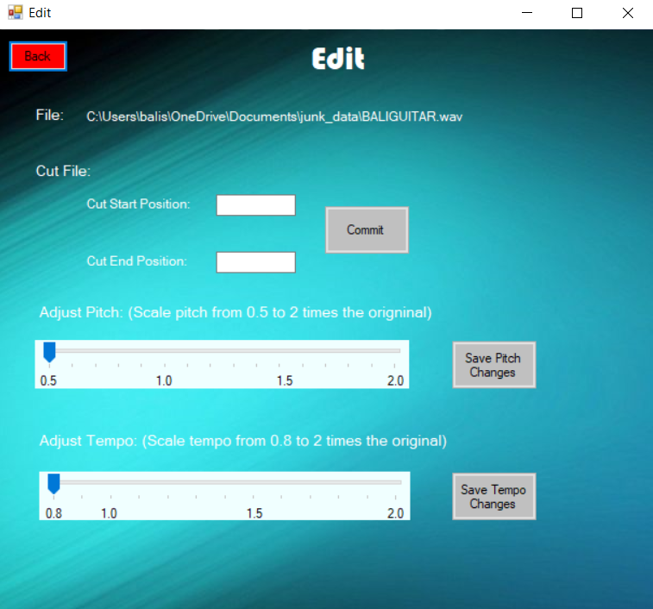
Screenshots (cont.)

Slide 8
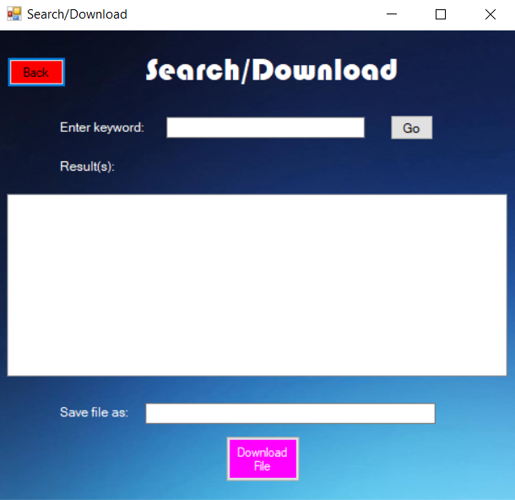
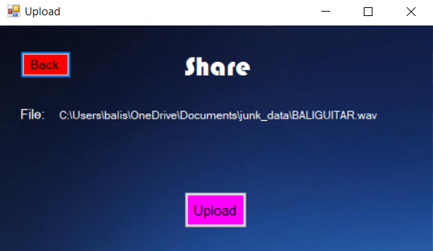
Screenshots (cont).

Slide 9
System Overview
Play Music (C#, Windows Media Player)
Edit Music (C#, FFMPEG)
Cut the file
Change the tempo
Change the pitch
Share Music (C#, IKVM, Java)
Client
The address of
the file in the
Server
User Music file
User login information
User request
（File name)
Share Music (Java, MySQL)
Save user login information
Save the file from the clients
Send the file to the client when the user request
Server

Slide 10
Technologies
Front End(Music Playing, Music Editing) - Windows Media Player, C#, FFMPEG
User Interface- Windows Forms in C#
Back End(Server for sharing music)- Java, MySQL
C# / Java simulator: IKVM
SCRUM Board- Trello.com
Group Communication- Slack
Version Control- GitHub

Slide 11
Project Management Strategies
Met frequently (at least 5 times a week)
Held consistent SCRUM meetings, updated SCRUM board, updated burnup chart
Consistent communication between team members
Enabled all members to know progress & challenge of one another
Frequent meetings with Sponsor, who had experience with server framework
Was able to offer insights on what he thought would work, and what seemed likely to fail
Group chat/collaboration via Slack

Slide 12
Things We Enjoyed, and Things We Did Not
Enjoyable:
Working together collaboratively and creatively
Group effort resulting in a tangible product
Learning & implementing server from scratch (for the first time!!)
Not Enjoyable:
Constantly updating documentation (somewhat tedious)
Having to debate and come to compromise on decided structure of product
Necessary changing of technologies/strategies when it became clear they were impractical

Slide 13
Lessons Learned
Implementation of tasks often takes longer than expected
Important to not get too off topic during a SCRUM meeting; leave dispute to be handled by those involved after meeting
Effective communication is key; speaking clearly, concisely, and to the point is tremendously helpful
Being honest and voicing concern early is necessary, while hiding your concerns can be detrimental

Slide 14
What Worked, and What Did Not
What Worked:
Voicing concerns early; letting the group know how progress was coming along
Adapting to new revelations, and changing structures or technologies as a response
What Didn’t Work:
Rambling speech; speaking in a roundabout way without getting to the point
Getting sidetracked during SCRUM Meetings

Slide 15
Looking to the Future
What We Wish We’d Done
Had better foresight on what technologies to use; what would work well together
Created a sleeker user interface
Future Build Features
Combine audio tracks together (splice, concatenate, etc.)
Increased precision for pitch and tempo editing (by semitone, by BPM, etc)
Allow users to listen to their edits in real time
Ability to comment on other users’ uploaded files

